Slide 1

Flipkart Demo
BY:- SHUBHAM DUBEY

Slide 2
Content
Requirements
Technology used
Draw.io Design
Problem I faced & How I resolved them
Live Demo Link

Slide 3
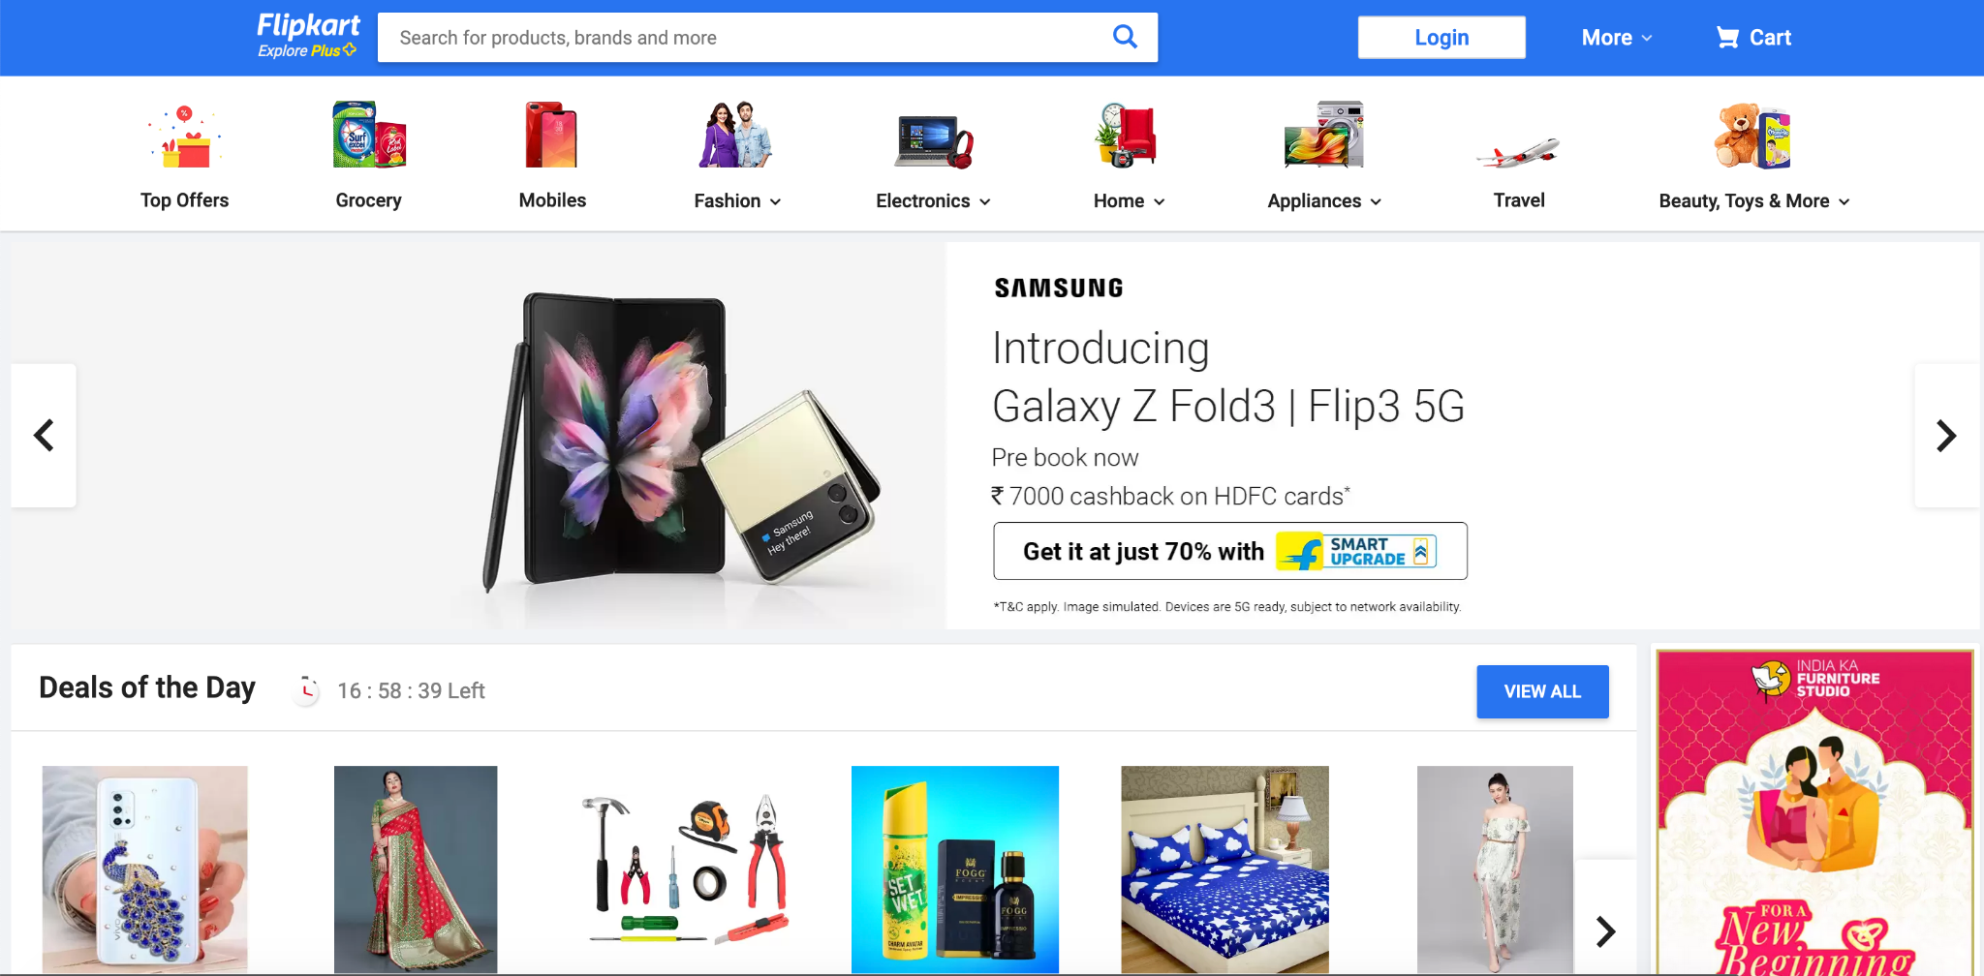
Requirement
To create official flipkart landing page

Slide 4
Technology used
HTML:- Basic structure
CSS:- For styling

Slide 5
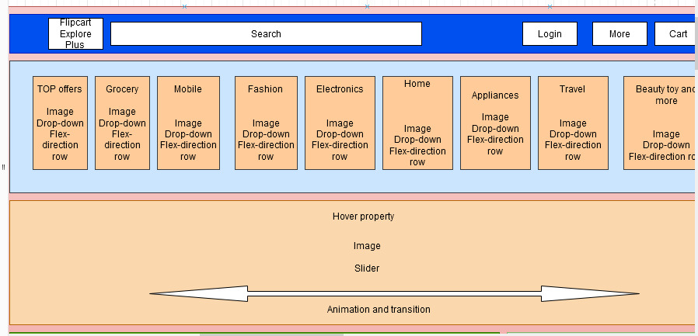
Draw.io Design
1.a)Initial Flipkart landing page

Slide 6
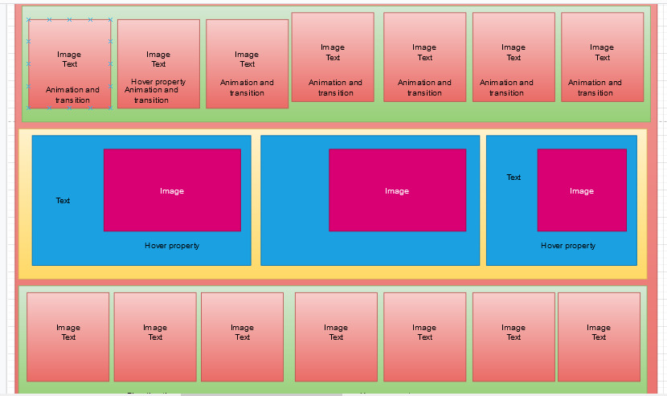
Draw.io Design
1.b)Rest half flipkart landing page

Slide 7
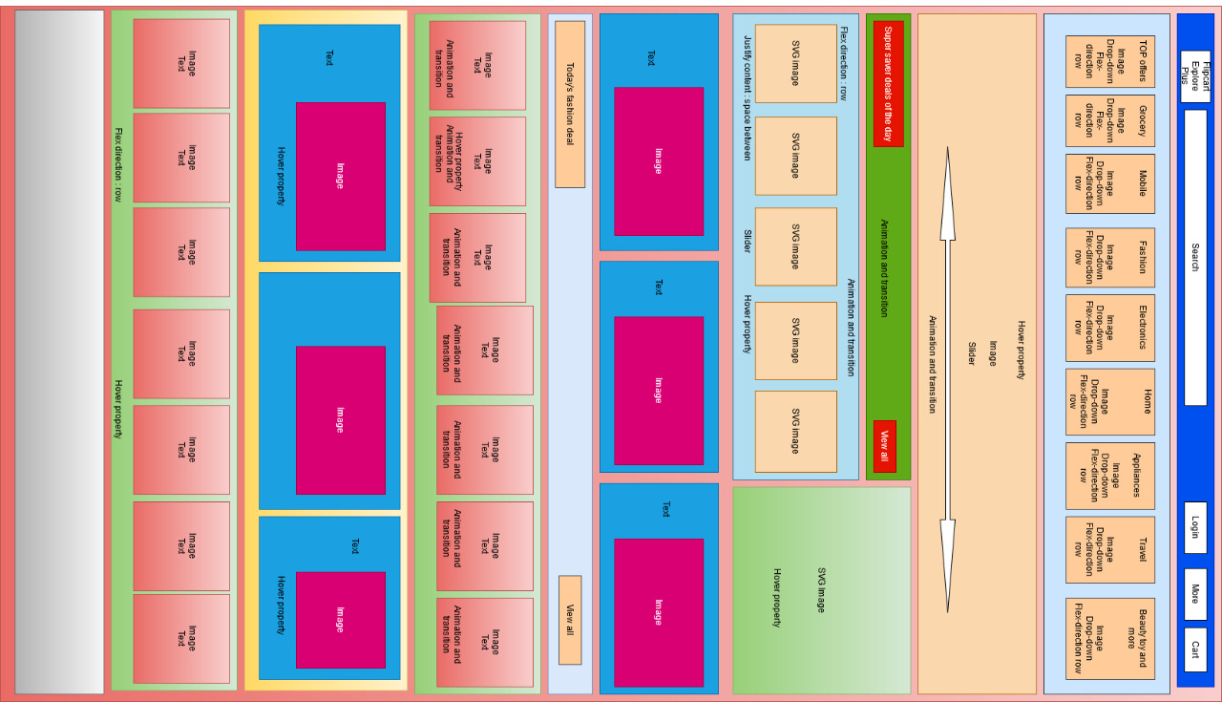
Draw.io Design
Full Draw.io Design of Flipkart page

Slide 8
Problem I faced & How I resolved them
When I was creating this web page the actual problem was slider and responsive web page so I am currently learning JavaScript to make this page responsive

Slide 9
Live Demo Link
www.github.io/blahblah
FIN.
Thank you

